Slide 1
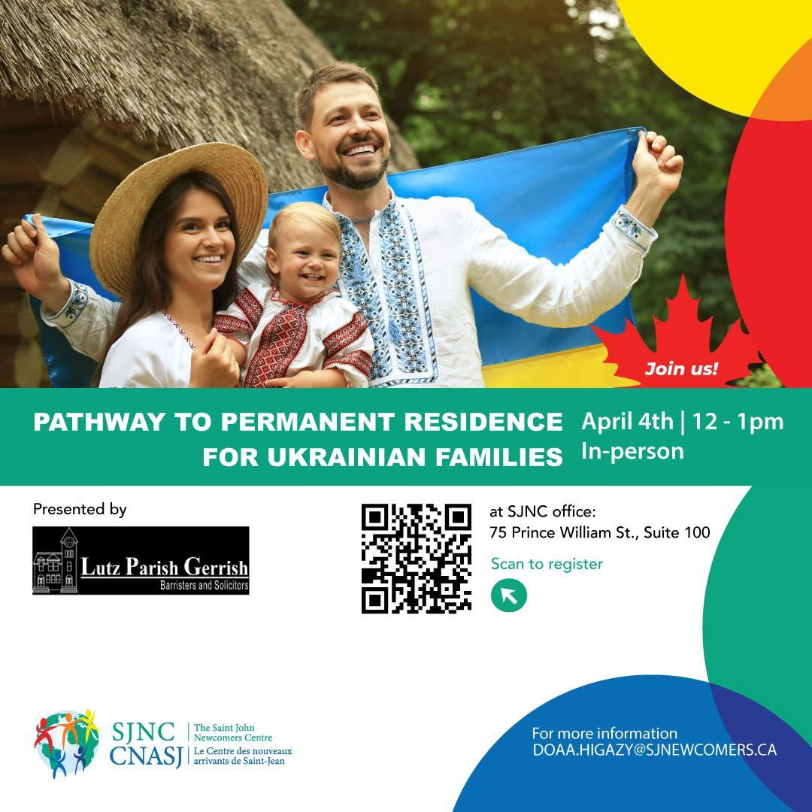
PATHWAY TO PERMANENT RESIDENCE FOR UKRAINIAN FAMILIES

Slide 2
Permanent Residence Pathways:
1)Permanent residence for Ukrainian nationals with family members in Canada (deadline October 2024);
2)Express Entry;
3)Non-Express Entry(Provincial Nomination);

Slide 3
1)Permanent residence for Ukrainian nationals with family members in Canada. Who can apply:
Category 1: A family member of a Canadian citizen or permanent resident in Canada
You must
be a Ukrainian national
be a family member of a Canadian citizen or permanent resident including their:
  spouse or common-law partner
  child (regardless of age)
  grandchild
  parent
  grandparent, or
  sibling (or half-sibling)
be in Canada when:
  you submit your application
  you’re granted permanent residence

Slide 4
Category 2: A spouse or common-law partner of a Ukrainian national with family in Canada
You must be the spouse or common-law partner of a Ukrainian national.
Your spouse or partner must:
be unable to leave Ukraine, be missing, have passed away, or have presumed to have passed way
be the family member of a Canadian citizen or permanent resident including their:
  child (regardless of age)
  grandchild
  parent
  grandparent, or
  sibling (or half-sibling)
You must:
be in Canada when:
  you submit your application
  you’re granted permanent residence

Slide 5
How to apply: online
  Sign in or create a Permanent residence online application portal account
  From the list, select the program under which you are applying:
  Other
  From the list, select the category under which you are applying:
  Ukraine Family Reunification Public Policy, if you intend to reside outside of Quebec
  Ukraine Family Reunification Public Policy QC, if you intend to reside in Quebec
  The Instruction Guide (IMM 0189), will help you fill out the forms properly.

Slide 6
Documents checklist
-Generic Application Form for Canada(IMM 0008);
-Additional Dependents Declaration (IMM 0008DE);
-Background Declaration (IMM 5669)(re jobs, unemployments, study, vacations);
-Additional Family Information (IMM 5408);
-Statutory Declaration Attesting Relationship (IMM 0191);

Slide 7
-photos;
-proof of status in Canada;
- Identification Documents;
-Marriage/Divorce/Death Certificate;
-Police Certificate;
*All documents should be in English or French or translated into English or French + Affidavit from the person who completed translation

Slide 8
2)Express Entry. How to apply
Register and Sign in to your account.
Click the link to apply for permanent residence under Express Entry.
When filling out the form:
Submit all of the required documents.
All of your answers must be complete and true.
Complete all the mandatory fields are completed

Slide 9
Express Entry Streams:
Canadian Experience Class
Federal Skilled Worker
Business Immigration Programs
Skilled Trades

Slide 10
Documents for Express Entry
a passport or travel document
language test results
proof of Canadian education or an educational credential assessment report for immigration purposes if
  you’re applying through the Federal Skilled Workers Program, or
  you want to get points for the education you got outside Canada
provincial nomination (if you have one)
written job offer from an employer in Canada (if you have one)
proof of work experience
certificate of qualification in a trade occupation issued by a Canadian province or territory (if you have one)
proof of funds (if you apply outside of Canada or live in Canada less than 12 months)
police certificate
Marriage/Divorce/Death/Adoption Certificate
photo

Slide 11
non-Express Entry
Nomination under an Express Entry PNP stream: If you are not already in the Express Entry pool, you will need to complete an Express Entry profile and be accepted into the pool. You can begin the process by using our Come to Canada tool.
OR
Nomination under a non-Express Entry PNP stream: Permanent resident applicants who were nominated under a non-Express Entry PNP stream should apply for permanent residence using the regular application process

Slide 12
Provincial Nominee Program (e.g. New Brunswick)
Canadian Experience Class
for skilled workers who have Canadian work experience
work experience must have been gained in the 3 years before you apply
Federal Skilled Worker Program
for skilled workers with foreign work experience
must meet criteria for education and other factors
Federal Skilled Trades Program
for skilled workers who are qualified in a skilled trade
must have a valid job offer or a certificate of qualification

Slide 13
New Brunswick Immigration Program Streams
-New Brunswick Express Entry Stream
-New Brunswick Strategic Initiative Stream
-New Brunswick Private Career College Graduate Pilot Program
-New Brunswick Skilled Worker Stream
- New Brunswick Business Immigration Stream
-Atlantic Immigration Program (endorsed by a designated employer)

Slide 14
How to apply:
Nomination under an Express Entry PNP stream: If you are not already in the Express Entry pool, you will need to complete an Express Entry profile and be accepted into the pool. You can begin the process by using our Come to Canada tool.
OR
Nomination under a non-Express Entry PNP stream: Permanent resident applicants who were nominated under a non-Express Entry PNP stream should apply for permanent residence using the regular application process
More:https://www2.gnb.ca/content/dam/gnb/Corporate/Promo/Immigration/express-entry-program-guide-february-2024.pdf

Slide 15
non-Express Entry Documents checklist:
-Travel Document
- Work experience proof
-Language Test Results
-Educational Credential Assessment
- Police Certificate
- Marriage/Divorce/Death/Adoption Certificate
- Photo
-Proof of Funds
-Information for your employer (if applicable)

Slide 16
After you apply:
-Check your application status, if you are approved:
-Get medical exams, criminal checks, biometrics;
- Pay the fees;
-Make sure the documents are valid;
- Confirm your Permanent Residence Status Online and
-Wait for your PR Card

Slide 17
Useful links:
PR for Ukrainian Families: https://www.canada.ca/en/immigration-refugees-citizenship/services/immigrate-canada/ukraine-measures/pr-family-reunification.html
NB Express Entry Steam: https://www2.gnb.ca/content/dam/gnb/Corporate/Promo/Immigration/express-entry-program-guide-february-2024.pdf
New Brunswick Immigration Program Steams:
https://www2.gnb.ca/content/gnb/en/corporate/promo/immigration/immigrating-to-nb/nb-immigration-program-streams.html

Slide 18
Questions
difficulties you have encountered?
different laws in Canada
justice system
immigration in general
next steps

Slide 19
Thank you

